Slide 1
JAIN UNIVERSITY
SCHOOL OF ENGINEERING
Department of Computer Science and Technology
Major Project Phase-I
Zeroth Review
MULTISPECTRAL SATELLITE IMAGE DEHAZING
Presented By:
G Sai Avinash
Shaistha M
Naga Kushal Ageeru Nishen Ganegoda
19BTRCR048
19BTRCR014
19BTRCR047
19BTRCR061
Guide :Dr.M.John Basha

Slide 2


Overview
Introduction
Problem Statement
Objectives
Scope of the Project
State of the Art work
Novelty of idea & Societal/ environmental impact
Functional Requirements
Non-Functional Requirements
System/Software Requirements
Deliverables
References

Slide 3


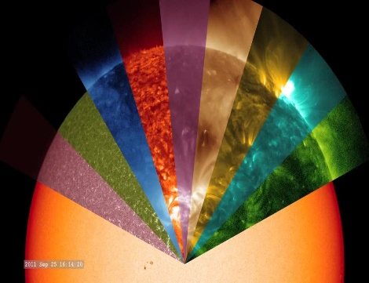
Introduction
In recent years there has been a growing interest in using satellite imagery for different tasks in modeling the earth, e.g. creating accurate maps. For this to be possible the satellite images must have a high enough resolution to be able to detect small details.
The usability of the images does not only depend on their resolution but heavily on the quality of their content as well.
One great disadvantage when taking images from outside of the atmosphere is that the result will be distorted since the light is forced to pass through particles in the atmosphere which will scatter and absorb the light.
The distortion will reduce the applicability of the resulting images if they are not corrected. Since these effects are inevitable in the field of remote sensing it is important to have effective methods to remove them.

Slide 4
Introduction
A multispectral image dehazing tries to improve interpretability in the image regions affected by the presence of haze during acquisition.
In remote sensing, optical multispectral satellite images often suffer from the presence of haze resulting in a lack of contrast and data interpretation.
The process of dehazing tries to recover the information affected due to the presence of haze and therefore servers to increase the data interpretation for manual or automated operations. Haze detection and removal is a challenging and important task for optical multispectral data correction.

Slide 5
Problem Definition
Images captured in hazy or foggy weather conditions make the object features difﬁcult to identify by human vision. Accuracy is also the main drawback where we can find an average accuracy of 60% to 70%, which should be increased.

Slide 6
Objective
The main objective is to improve the visual quality. Images with good quality help users fully understand the information and see a clear quality image.
To improve colour fidelity in remote sensing images.
To build a user friendly interface.
To improve the accuracy of the hazed image

Slide 7
Scope of the project
By using this model we are going to tackle the problem faced while recognizing hazed image.
In this project we are going to compare different methods and bring out the best method out of it.
An end to end user interface will be created were there will be provision to view and download the clear image.

Slide 8
State of the Art-work
SL.NO | Author’s Name/ Paper Title | Conference/Journal Name and year | Technology/ Design | Results shared by author | What you infer
1.) | Juping Liu 1,2, Shiju Wang 1 , Xin Wang 1 , Mingye Ju 1,* and Dengyin Zhang 1 A Review of Remote Sensing Image Dehazing | Multidisciplinary Digital Publishing Institute[MDPI] (2021) | Physical Dehazing, Estimating the Transmission. Data-Driven Based Dehazing, Dehaze Net, Remote Sensing Dehazing Image Quality Evaluation, | As a result, the anticipated models accounts for the majority of its success in terms of dehazing performance. The most frequent quantitative measures and the RS application scenario Dehazing techniques were also shown. | Here we have seen that he imaging theory of hazy data is ignored in image enhancement, which primarily emphasizes the maximization of local or global contrast.
2.) | ZHIJIE HE, CAILAN GONG, YONG HU, AND LAN LI Remote Sensing Image Dehazing Based on an Attention Convolutional Neural Network | IEEE Xplore (2019) | Remote sensing, Atmospheric modeling, Feature extraction,Kernel,Image restoration, Neural networks, Degradation | The heterogeneous haze in some areas of the remote sensing images were effectively removed. In both the haze residue level and evaluation index, this method was superior to the conventional dark channel method, DehazeNet, and AOD-NET | In this paper we have seen for images taken in the same area, the background information in hazy images acquired on different days varied due to factors like different lighting conditions.

Slide 9
SL.NO | Author’s Name/ Paper Title | Conference/Journal Name and year | Technology/ Design | Results shared by author | What you infer
3.) | Yongfei Guo,1Zeshu Zhang,1and Hangfei Yuan1 Single Remote Sensing Multispectral Image Dehazing Based on a Learning Framework | Hindawi journal 2019 | The processing of single hazy image has a significant progress in Some methods based on polarization have been developed in which the development of deep learning, | indicate that compared with the state-of-the art methods, our proposed dehazing method can effectively remove haze in each band of multispectral images under different scenes | The proposed haze synthesis method can generate haze highly close to real conditions, using which to train the dehazing network.
4.) | K. Mounika, N. Harika Reddy, Kalagasahitya, K.V. Alekhya, Karaka Jyoshna, P.Sai Gayathri, K SatyaPriya DEHAZING FOR MULTISPECTRAL REMOTE SENSING IMAGES | International Research Journal of Modernization in Engineering Technology And Science 2019 | The hazy image and its corresponding transmission map is detected effectively based on learning the coefficients of the linear model. | A linear regression model with multiple variables is established and the gradient descent method is applied to the coefficients of the linear model. Then a hazy image accurate transmission map is obtained. | The proposed method can recover a haze-free remote sensing image with good visual effect and high quality.

Slide 10
SL.NO | Author’s Name/ Paper Title | Conference/Journal Name and year | Technology/ Design | Results shared by author | What you infer
5.) | Ravi Raj Choudhary, K K Jisnua, Gaurav Meenaa Image DeHazing Using Deep Learning Techniquesa | International Conference on Computational Intelligence and Data Science (ICCIDS 2019)z | Using Computer vision, Convolutionary neural network to create a model to achieve dehazed image | This paper present a deep-learning approach that generates haze free images without any human intervention. | By chnaging the hyper paratmeters in the model we could achive more accuracy and get more clear dehazed image.
6.) | Binghui Huang1∗, Zhi Li2∗, Chao Yang1, Fuchun Sun1. Single Satellite Optical Imagery Dehazing using SAR Image Prior Based onconditional Generative Adversarial Networks | Workshop on Applications of Computer Vision paper 2020. | Using generative adversarial network to create model to achieve required result. | In this paper In order to produce better dehazed results,they proposed a novel architecture introducing SAR prior aslimits to reconstruct original details, which can be trainedend-to-end to generate natural haze removal images. | Using GANS is also a way where we can create machine learning model in which two neural networks compete with each other to become more accurate in their predictions.

Slide 11
SL.NO | Author’s Name/ Paper Title | Conference/Journal Name and year | Technology/ Design | Results shared by author | What you infer
7.) | Manjun Qin,Wei Li. Dehazing for Multispectral Remote Sensing Images Based on a Convolutional Neural Network With the Residual Architecture | IEEE Xplore 2018 | Designed Dehazing Framework, Adaptive Fusion, Haze Synthesis Method | The designed network includes two parts. One is the parallel connection of multiple CNN individuals with residual structure. Each individual is used to learn a regression from the hazy image to the clear image. | in this paper, a novel haze removal method based on the deep CNN is proposed for multispectral remote sensing image
8.) | Akash Ramjyothi,Santonu Goswami CLOUD AND FOG REMOVAL FROM SATELLITE IMAGES USING GENERATIVE ADVERSARIAL NETWORKS (GANs) | HAL (open archive) 2021 | Image Matting,Generative Adversarial Networks | In our future study, multi-source data will be incorporated with the target image to allow the proposed method to better cope with the reconstruction of cloud-contaminated areas suffering significant land-cover changes. | In this paper, with the aim of improving the cloud removal results in high-resolution satellite images, which often suffer from the problems of radiometric distortion, noise and artifacts.

Slide 12
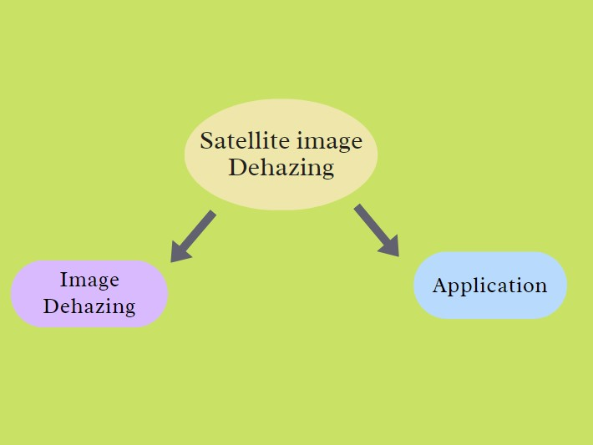

Slide 13
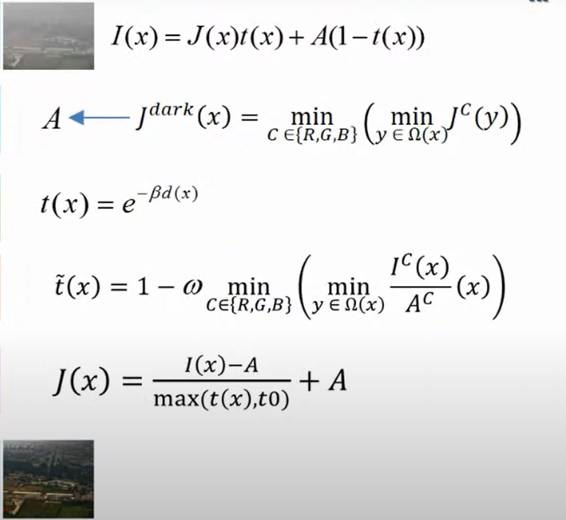
Image Dehazing using Dark Channel Prior
Haze Image
Atmospheric Light estimation
Transmission Map
Refine Transmission Map
Radiance Recovering
Dehaze Image

Slide 14
Application
Estimation of Air Pollution with Remote Sensing Data
Air pollution and the emission of GHGs are the main cause of climate change.
Anthropogenic GHG emissions from the combustion of fossil fuels in industrial plants or vehicles are harmful to the environment and contribute to global warming trends

Slide 15
Problem Statement
Air pollution measurements from ground stations provide frequent measurements but lack spatial coverage.
Satellites provide large spatial coverage but low spatial resolution and little information about a pollutant’s vertical distribution.
Estimation of pollutant concentrations near the surface, where they originate, is a non-trivial task.

Slide 16
Previous works
Land Use Regression (LUR)
Kriging

Slide 17
Proposed system
This work utilizes temporal surface NO2 measurements from 3000+ air quality stations across Europe, averaged for the 2018-2020 timeframe. Additionally, multi-band remote sensing data from the ESA Sentinel-2 satellite as well as tropospheric NO2 column density values from Sentinel-5P are collected at the locations of air quality stations.
By leveraging globally available remote sensing data and deep learning in lieu of detailed, country specific input datasets, we strive to enable the estimation of surface level air pollutants at high spatial resolution for any location on Earth.

Slide 18
Air pollution and green house gas?
Air pollution and the emission of GHGs are the main cause of climate change.
Anthropogenic GHG emissions from the combustion of fossil fuels in industrial plants or vehicles are harmful to the environment and contribute to global warming trends.
Besides the primary GHG, CO2, the burning of fossil fuels also emits molecules like NO2 and CO, which can be used as proxies for the estimation of CO2 emissions
Air pollution measurements from ground stations provide frequent measurements but lack spatial coverage.

Slide 19
What is NO₂
Nitrogen (IV) oxide or Deutoxide of nitrogen. It is one of the major atmospheric pollutants that absorb UV light and stops to reach the earth’s surface.
Nitrogen (IV) oxide is a yellowish-brown liquid in its compressed form or reddish-brown gas. Its vapours are heavier when compared to air.
Over 98 percent of man-made N0, emissions result from Combustion with the majority due to stationary sources. Combustion generated oxides of nitrogen are emitted predominantly as nitric oxide, N0, a relatively harmless gas, but one which is rapidly converted in the atmosphere to the toxic nitrogen dioxide.
Nitrogen dioxide is also a precursor in the formation of nitrate serosols and nitrosamines

Slide 20
Environmental and health effects of nitrogen oxides
Elevated levels of nitrogen dioxide can cause damage to the human respiratory tract and increase a person's vulnerability to, and the severity of, respiratory infections and asthma.
Long-term exposure to high levels of nitrogen dioxide can cause chronic lung disease.
It may also affect the senses, for example, by reducing a person's ability to smell an odour.
High levels of nitrogen dioxide are also harmful to vegetation—damaging foliage, decreasing growth or reducing crop yields.
Nitrogen dioxide can fade and discolour furnishings and fabrics, reduce visibility, and react with surfaces.

Slide 21
Methodology
We present a supervised deep learning approach for the prediction of surface NO2 concentrations from Sentinel-2 and Sentinel-5P data.
Features of the Sentinel-2 image are extracted through a ResNet-50
The final prediction is produced by the “head”, a stack of 2 fully connected layers

Slide 22
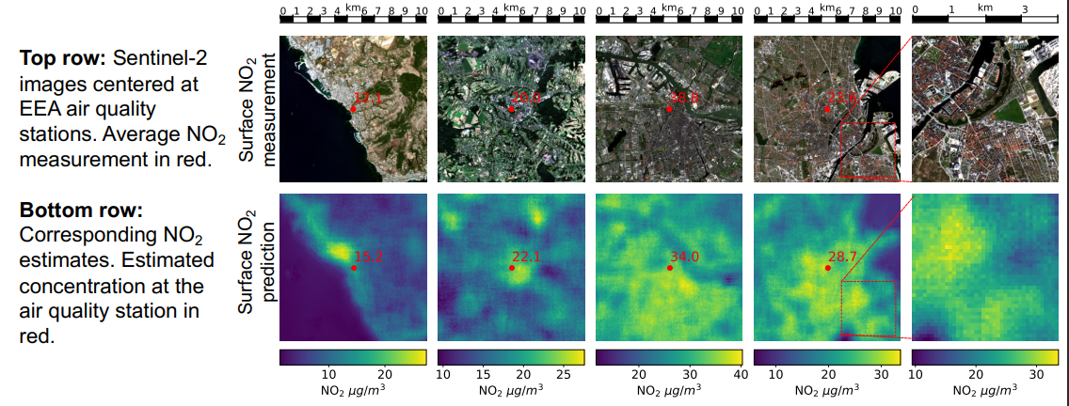
Example :
Punjab
Hyderabad
Bengaluru
Udaipur

Slide 23
State of the Art-work
SL.N O | Author’s Name/ Paper Title | Conference/J ournal Name and year | Technology/ Design | Results shared by author | What you infer
1.) | Yongfei Guo,1Zeshu Zhang,1and Hangfei Yuan1 Single Remote Sensing Multispectral Image Dehazing Based on a Learning Framework | Hindawi journal 2019 | The processing of single hazy image has a significant progress in Some methods based on polarization have been developed in which the development of deep learning, | indicate that compared with the state-of-the art methods, our proposed dehazing method can effectively remove haze in each band of multispectral images under different scenes | The proposed haze synthesis method can generate haze highly close to real conditions, using which to train the dehazing network.
2.) | K. Mounika, N. Harika Reddy, Kalagasahitya, K.V. Alekhya, Karaka Jyoshna, P.Sai Gayathri, K SatyaPriya DEHAZING FOR MULTISPECTRAL REMOTE SENSING IMAGES | International Research Journal of Modernization in Engineering Technology And Science 2019 | The hazy image and its corresponding transmission map is detected effectively based on learning the coefficients of the linear model. | A linear regression model with multiple variables is established and the gradient descent method is applied to the coefficients of the linear model. Then a hazy image accurate transmission map is obtained. | The proposed method can recover a haze-free remote sensing image with good visual effect and high quality.

Slide 24
SL.N O | Author’s Name/ Paper Title | Conference/J ournal Name and year | Technology/ Design | Results shared by author | What you infer
3.) | Ravi Raj Choudhary, K K Jisnua, Gaurav Meenaa Image DeHazing Using Deep Learning Techniquesa | International Conference on Computational Intelligence and Data Science (ICCIDS 2019) | Using Computer vision, Convolutionary neural network to create a model to achieve dehazed image | This paper present a deep-learning approach that generates haze free images without any human intervention. | By chnaging the hyper paratmeters in the model we could achive more accuracy and get more clear dehazed image.
4.) | Manjun Qin,Wei Li. Dehazing for Multispectral Remote Sensing Images Based on a Convolutional Neural Network With the Residual Architecture | IEEE Xplore 2018 | Designed Dehazing Framework, Adaptive Fusion, Haze Synthesis Method | The designed network includes two parts. One is the parallel connection of multiple CNN individuals with residual structure. Each individual is used to learn a regression from the hazy image to the clear image. | in this paper, a novel haze removal method based on the deep CNN is proposed for multispectral remote sensing image

Slide 25
Novelty of idea & Societal/ environmental impact
The Novelty which we have included in our project is the testing of different methods to implement dehazation and coming out with the best method from it.
A user friendly interface is added along with the CNN model running in the backend.

Slide 26
Functional Requirements
Good quality dehazed image and help users fully understand the information from the image dataset.
The system should be able to do the following:
The system accepts the inputs hazed image and extract.
Provide a improvised version of the image with higher quality .
Allow users view and download the clear image .

Slide 27
Non-Functional Requirements
User friendly web interface.
The proposed project model is reliable as it classifies and generates text description of an image and audio signal.
The proposed project model is robust as it undergoes data training.
Basic interpretation of data over a given period.
Provide basic analysis of the values read.
Availability
Good Accuracy

Slide 28
Software/System Requirements
System requirements
Operating system : WINDOWS/LINUX/MAC
RAM: 4-8GB
80 GB HDD
GPU:4GB(NVIDIA/AMD)
Software Requirements
Visual studio
Python version 3 and above version
Java version 8
Python libraries ( Numpy, pandas, sklearn, scipy, keras, TensorFlow).

Slide 29
References
"Deep residual learning for image recognition." Proceedings of the IEEE conference on computer vision and pattern recognition. 2016. Hoek, Gerard, et al.
"A review of land-use regression models to assess spatial variation of outdoor air pollution." Atmospheric environment 42.33 (2008): 7561-7578. Kefauver, Shawn C., Iolanda Filella, and Josep Peñuelas.
"Remote sensing of atmospheric biogenic volatile organic compounds (BVOCs) via satellite-based formaldehyde vertical column assessments." International journal of remote sensing35.21 (2014): 7519-7542. Konovalov, Igor B., et al. "Estimation of fossil-fuel CO 2 emissions using satellite measurements of" proxy" species.
" Atmospheric Chemistry and Physics 16.21 (2016): 13509-13540. Sumbul, Gencer, et al. "Bigearthnet: A large-scale benchmark archive for remote sensing image understanding." IGARSS 2019-2019 IEEE International Geoscience and Remote Sensing Symposium. IEEE, 2019.

